Slide 1

The Use of Contact Precautions to Prevent Transmission of MDROs: Emerging Evidence
James Ndai; Infection Preventionist
Aga Khan University Hospital Nairobi

Slide 2
Background
MDROs (MRSA, VRE, CRE, MDR-GNB) drive morbidity, mortality and costs in hospitals.
Contact precautions (gowns/gloves ± single-room) are widely used but resource-intensive..
CP 1970: limited HAIs surveillance; Poor H.H compliance, no use of ABHR, no CHG deco, no advanced tech for disinfection
Debate exists about their benefits vs potential harms
Recent evidence (2015–2025) questions universal routine CP for endemic MDROs and highlights bundle approaches
Notes:
One-line framing: This talk reviews 4 high-quality papers (2015-2025) to summarise current evidence and practical implications.

Slide 3
Objectives
Examine current evidence on CP for MDRO transmission.
Assess effectiveness of CP on patient outcomes, and alternatives.
Explore Enhanced Barrier Precautions (EBP) as emerging strategy.

Slide 4
Methods
This is not primary research but a structured literature review.
Databases searched: PubMed, Cochrane Library, and Web of Science.
Timeframe: 2015–2025.
Keywords: Contact precautions, Standard precautions multidrug-resistant organisms, MRSA, VRE, ESBL.
Inclusion criteria: High-quality studies — randomized controlled trials, systematic reviews, and meta-analyses.
Selection process: Among eligible studies, the four papers were chosen to represent emerging evidence.
Focus: Clinical outcomes (HAI rates, MDRO acquisition), adverse events, and feasibility of implementing CP vs. SP in different settings.

Slide 5
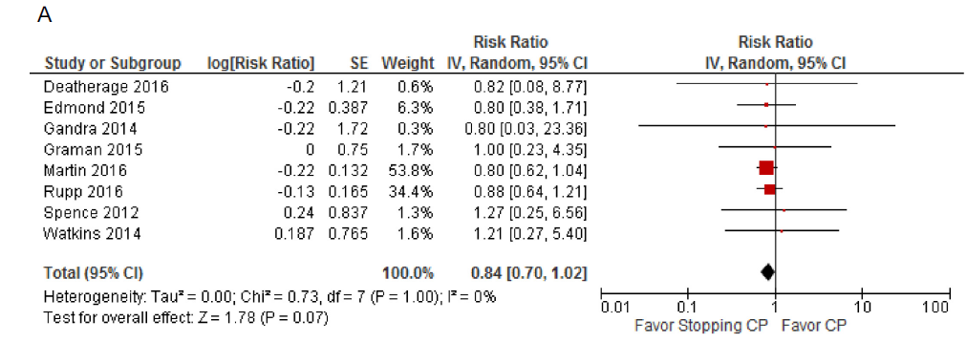
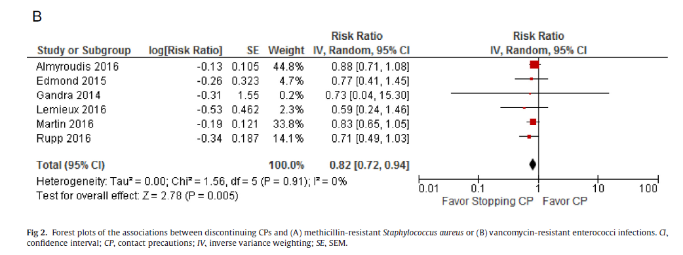
Study Evidence (1/4)
Author (Year) | Design | Sample Size | Findings | Conclusion
Marra et al. (2018) | Systematic review & meta-analysis | 9 studies; >127,000 patients | No increase in MRSA/VRE with discontinuation of CP | Stopping CP generally safe with no rise in infection rates

Slide 6
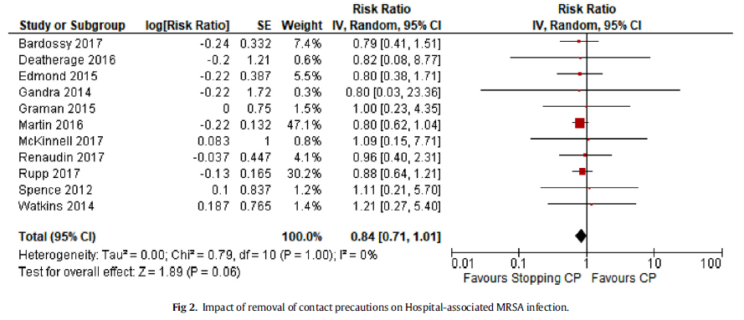
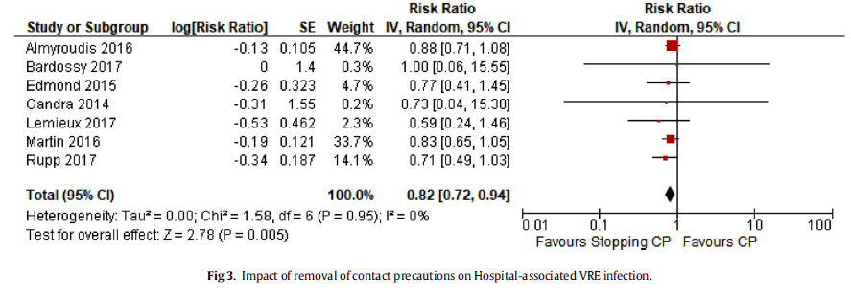
Study Evidence (2/4)
Author (Year) | Design | Sample Size | Findings | Conclusion
Kleyman et al. (2021) | Systematic review & meta-analysis | 14 studies; >150,000 patients | MRSA RR 0.84 (95% CI 0.71–1.01); VRE RR 0.82 (95% CI 0.72–0.94) | Removal of CP did not increase HAI rates, particularly for VRE

Slide 7
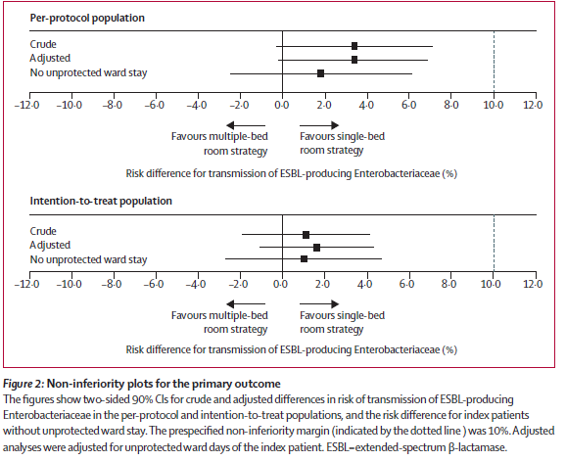
Study Evidence (3/4)
Author (Year) | Design | Sample Size | Findings | Conclusion
Kluytmans-van den Bergh et al. (2019) | Cluster-RCT, crossover, non-inferiority | 16 Dutch hospitals; 12,000+ patients | 4% vs 7% ESBL transmission (single vs multi-bed); within non-inferiority margin | Single-room CP non-inferior to multi-room; CP may not add significant benefit

Slide 8
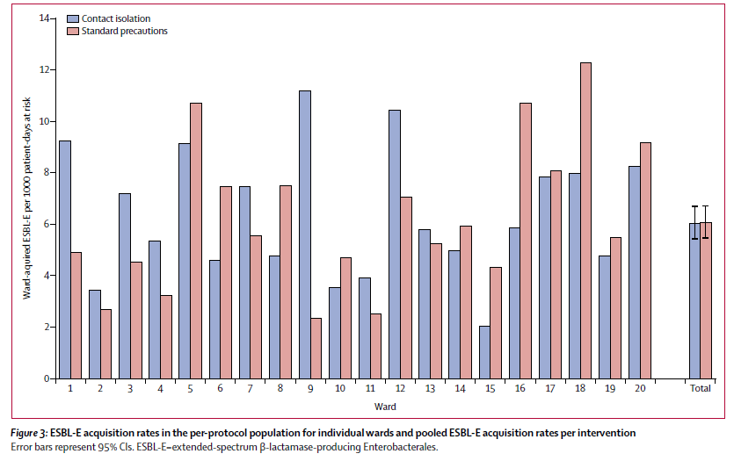
Study Evidence (4/4)
Author (Year) | Design | Sample Size | Findings | Conclusion
Maechler et al. (2020) | Cluster-randomised crossover trial | 20 wards; 18,000+ patients | Incidence: 6.0 vs 6.1/1000 patient-days (CP vs standard) | No significant difference; CP not superior to standard precautions

Slide 9
Cross-study Analysis
• Systematic reviews (2018, 2021) suggest CP discontinuation does not increase MRSA/VRE
• RCTs (2019, 2020) show no superiority of CP over standard precautions for ESBL control
• Evidence leans towards standard precautions as safe alternative
• Variability exists by pathogen type and hospital context

Slide 10
Contact Precautions (CP) | Standard Precautions (SP)
🚪 Patient isolation (single room/multi-bed with barriers) | 🧴 Routine hand hygiene + PPE as indicated
🧤 Mandatory gowns & gloves | 👨‍👩‍👧 Family-centered care, no stigma
📉 Shown effective in outbreaks & ICUs | 📈 Safe in stable settings with strong IPC programs
😟 Downsides: patient anxiety, fewer HCW visits, costly | ✅ Promotes workflow efficiency, patient comfort
Best use: ICU, outbreaks, resource-limited high MDRO burden | Best use: Stable settings, strong compliance, resource-rich hospitals

Slide 11
Implications for Infection Prevention
• CP may not be essential for all MDROs
• Focus may shift to:
- Hand hygiene compliance
- Environmental cleaning
- Antimicrobial stewardship
• CP still warranted in high-risk outbreaks or novel pathogens

Slide 12
Limitations of Evidence
• Heterogeneity in study designs and settings
• Most evidence from high-income countries
• Limited pediatric and ICU-specific data
• Need for more RCTs in diverse settings
Notes:
Heterogeneity in study designs refers to the differences or variations across studies that are included in a review, meta-analysis, or body of evidence. It means the studies are not all conducted in the same way, which can make it harder to directly compare or combine their results.

Slide 13
Conclusion
Emerging evidence suggests CP discontinuation may be safe for MRSA, VRE, and ESBL
Standard precautions remain highly effective across diverse settings
IPC programs should individualize policies based on pathogen, patient population, and resources
Application in high-resource settings: discontinuation feasible with strong hand hygiene, environmental cleaning, and antimicrobial stewardship
Application in low- and middle-income countries: caution warranted due to limited IPC resources; CP may still be essential in outbreak control
Pediatric and ICU settings: evidence limited—decisions should remain conservative
Overall: Contact precautions remain situationally important, but not universally necessary; flexible, evidence-based, and context-driven policies are recommended
Future research: needed in varied healthcare systems to confirm generalizability of findings

Slide 14
References
Biehl, L. M., et al. (2019). Impact of single-room contact precautions on MDR E. coli. Clin Microbiol Infect, 25(8), 1013–1020. https://doi.org/10.1016/j.cmi.2019.01.007
Biehl, L. M., & Vehreschild, M. J. G. T. (2020). Contact precautions: No benefits. Lancet Infect Dis, 20(6), 633–635. https://doi.org/10.1016/S1473-3099(20)30209-1
Browning, S., et al. (2024). Gown/glove vs. standard precautions for MRSA/VRE. Clin Microbiol Infect, 30(8), 973–976. https://doi.org/10.1016/j.cmi.2024.05.009
Diekema, D. J., et al. (2023). Are contact precautions essential for MRSA? Clin Infect Dis, 78(5), 1289–1294. https://doi.org/10.1093/cid/ciac783
Evans, M. E., et al. (2023). Active surveillance & CP for MRSA during COVID-19. Clin Infect Dis, 77(10), 1381–1386. https://doi.org/10.1093/cid/ciad076
Haessler, S., et al. (2020). Stopping routine CP for MRSA/VRE: Interrupted time series. Am J Infect Control, 48(12), 1466–1473. https://doi.org/10.1016/j.ajic.2020.06.208
Hagiya, H., & Otsuka, F. (2023). No benefit of CP for ESBL organisms: Review. Am J Infect Control, 51(9), 1056–1062. https://doi.org/10.1016/j.ajic.2023.04.014
Kullar, R., et al. (2016). Degowning CP controversies for MRSA. Am J Infect Control, 44(1), 97–103. https://doi.org/10.1016/j.ajic.2015.06.034
Most, Z. M., et al. (2024). Discontinuation of CP for MRSA in pediatrics. J Pediatric Infect Dis Soc, 13(2), 123–128. https://doi.org/10.1093/jpids/piad020
Kleyman, R., et al. (2021). Removal of CP for MRSA/VRE: Meta-analysis. Am J Infect Control, 49(6), 784–791. https://doi.org/10.1016/j.ajic.2020.12.011
Kluytmans-van den Bergh, M. F. Q., et al. (2019). CP in single vs. multi-bed rooms: ESBL study. Lancet Infect Dis, 19(10), 1069–1079. https://doi.org/10.1016/S1473-3099(19)30262-2
Maechler, F., et al. (2020). CP vs. standard precautions for ESBL: RCT. Lancet Infect Dis, 20(5), 575–584. https://doi.org/10.1016/S1473-3099(19)30626-7
Marra, A. R., et al. (2018). Discontinuing CP for MDROs: Meta-analysis. Am J Infect Control, 46(3), 333–340. https://doi.org/10.1016/j.ajic.2017.08.031

